Slide 1
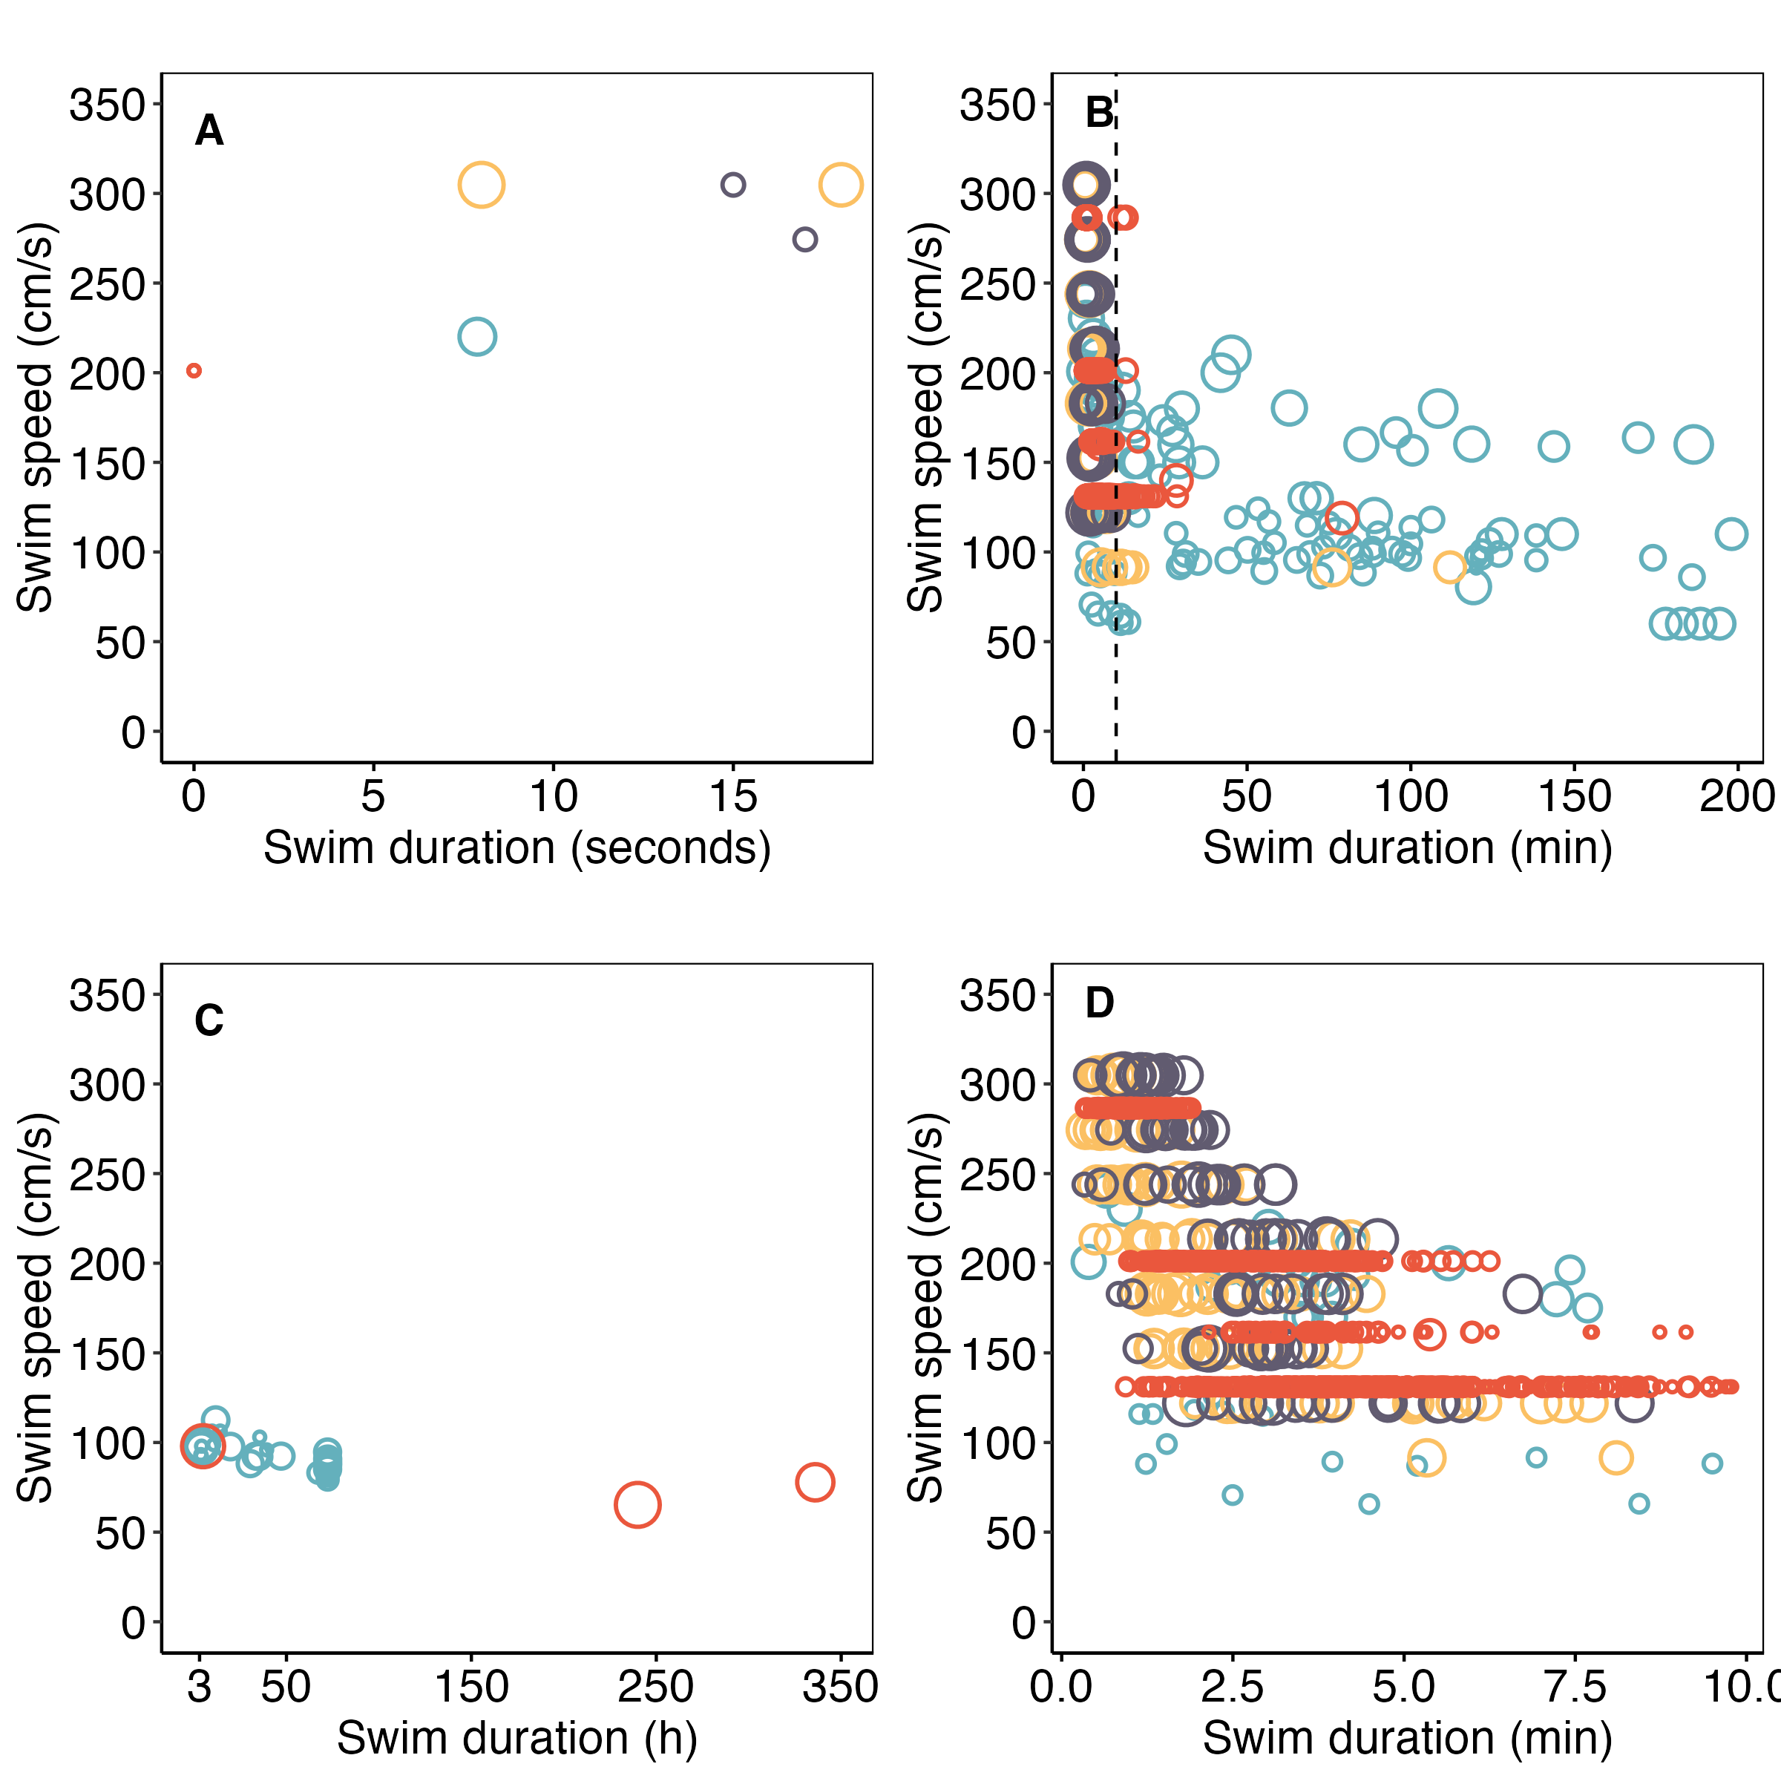

BURST (anerobic)
UNSTEADY
(anaerobic, and aerobic)
STEADY (aerobic)

Slide 2
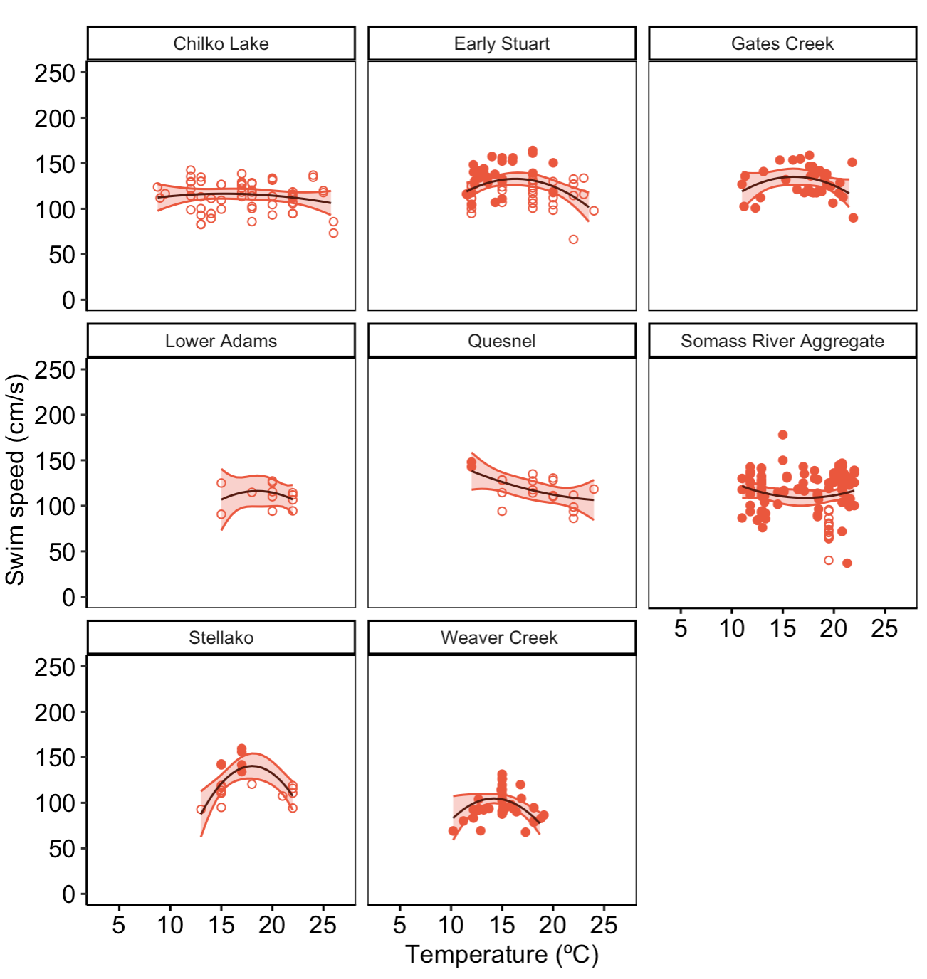

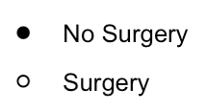
O. nerka
Panels = populations

Slide 3
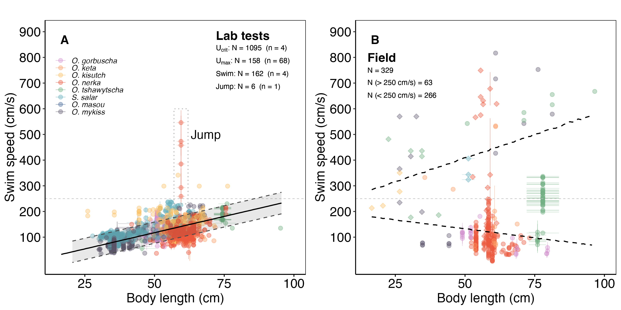
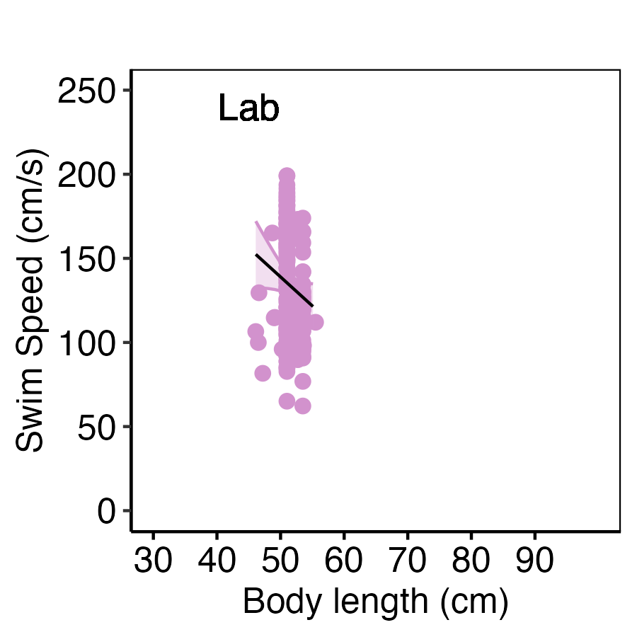
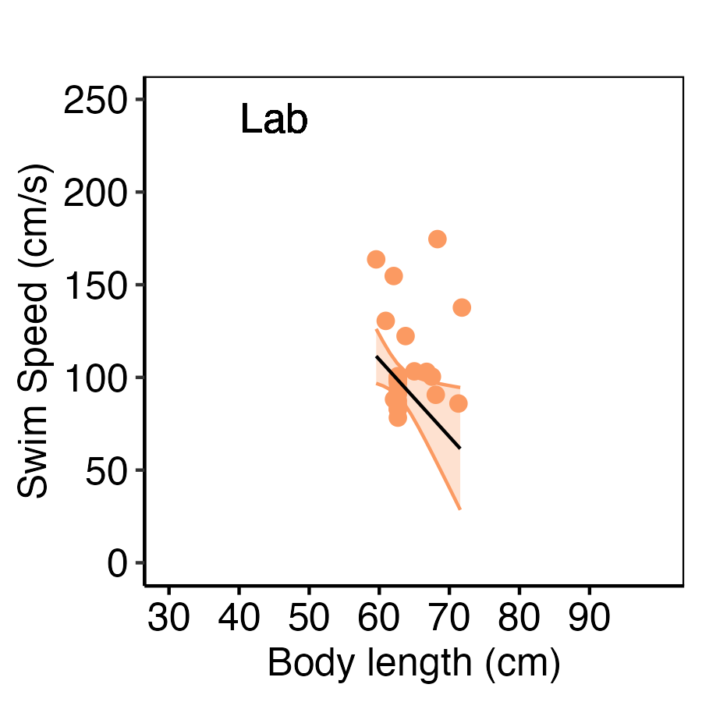
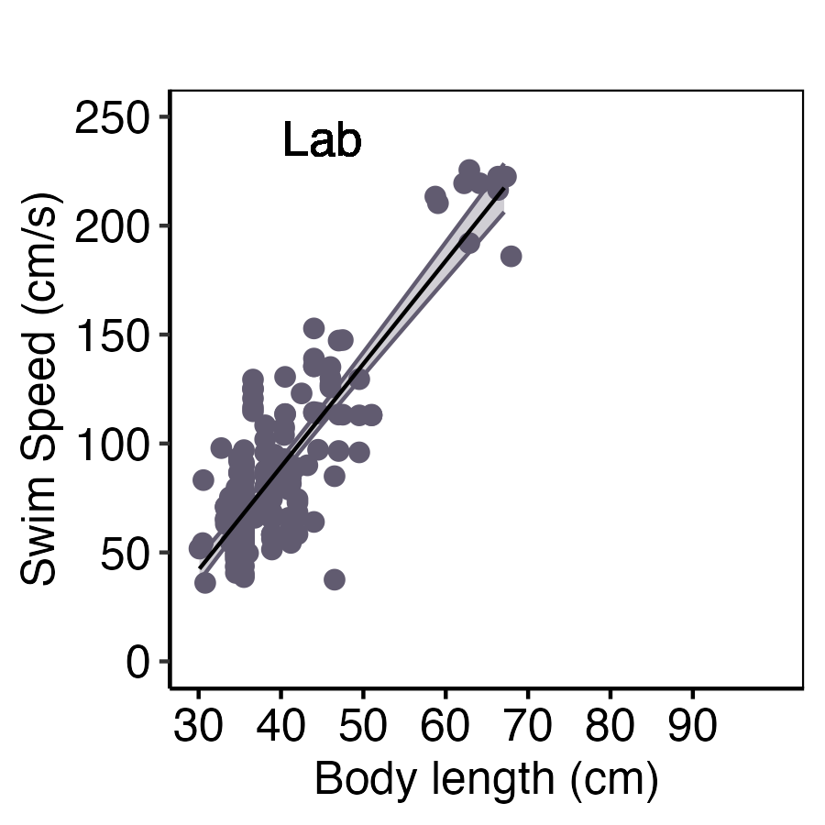
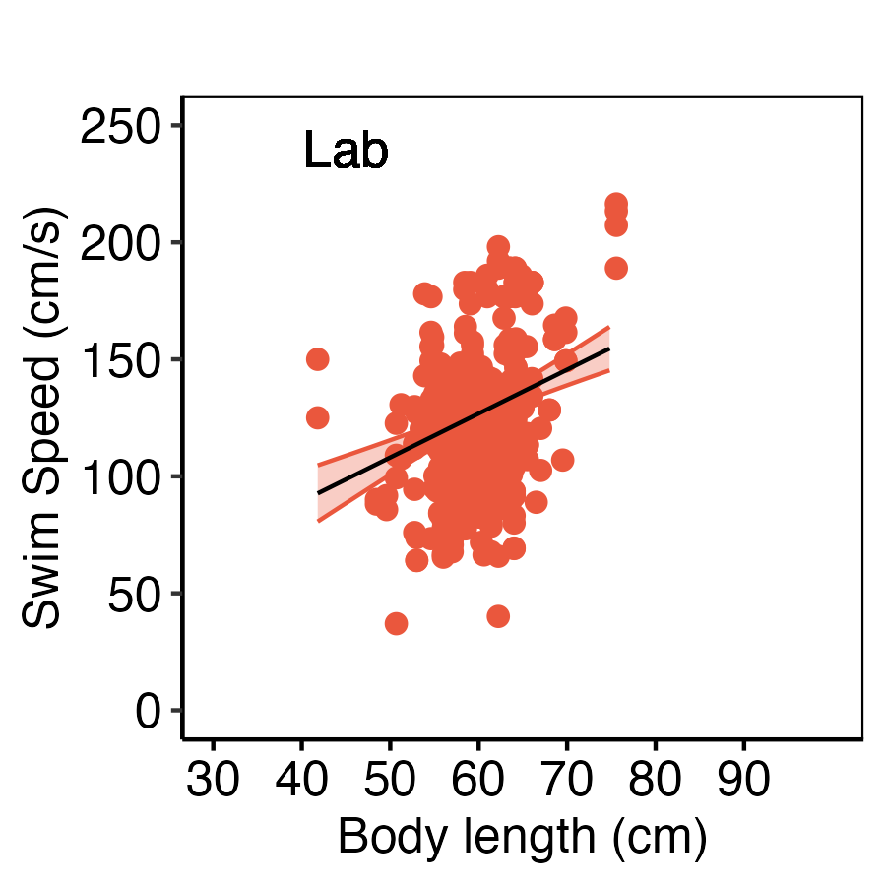
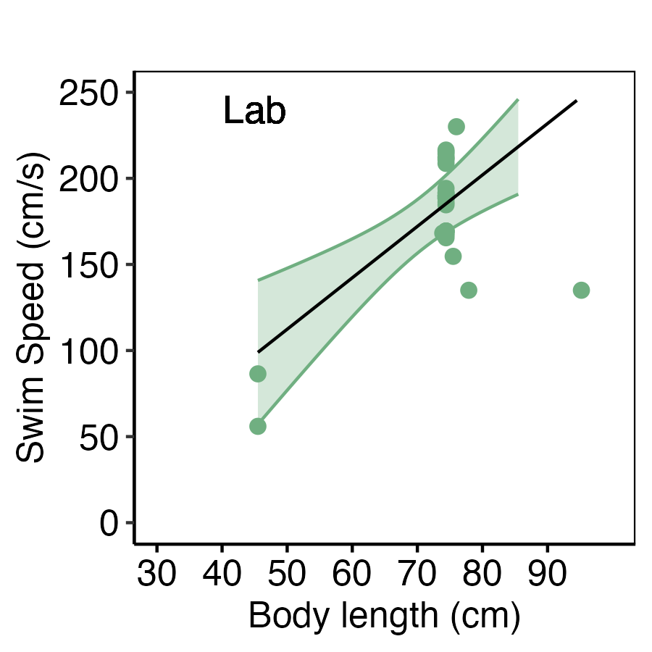
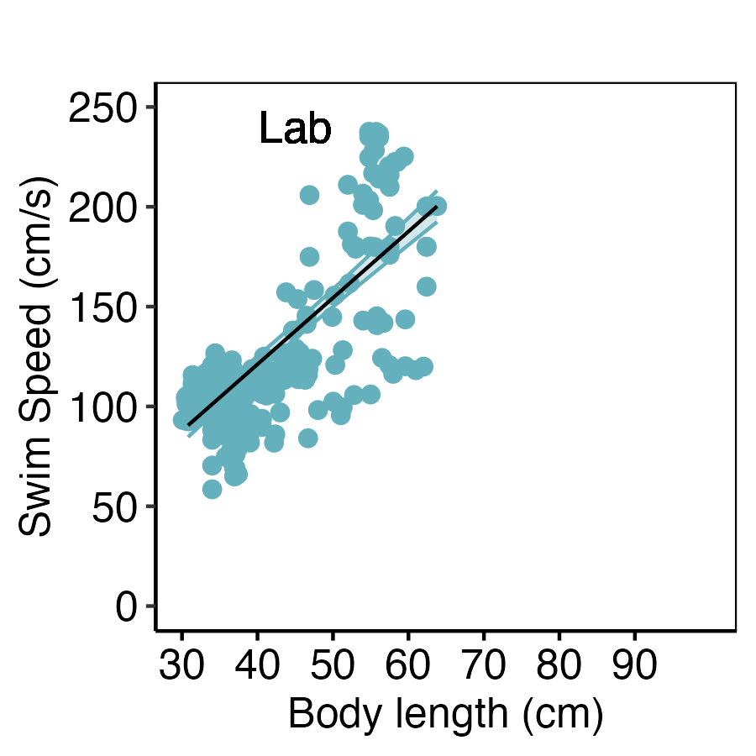
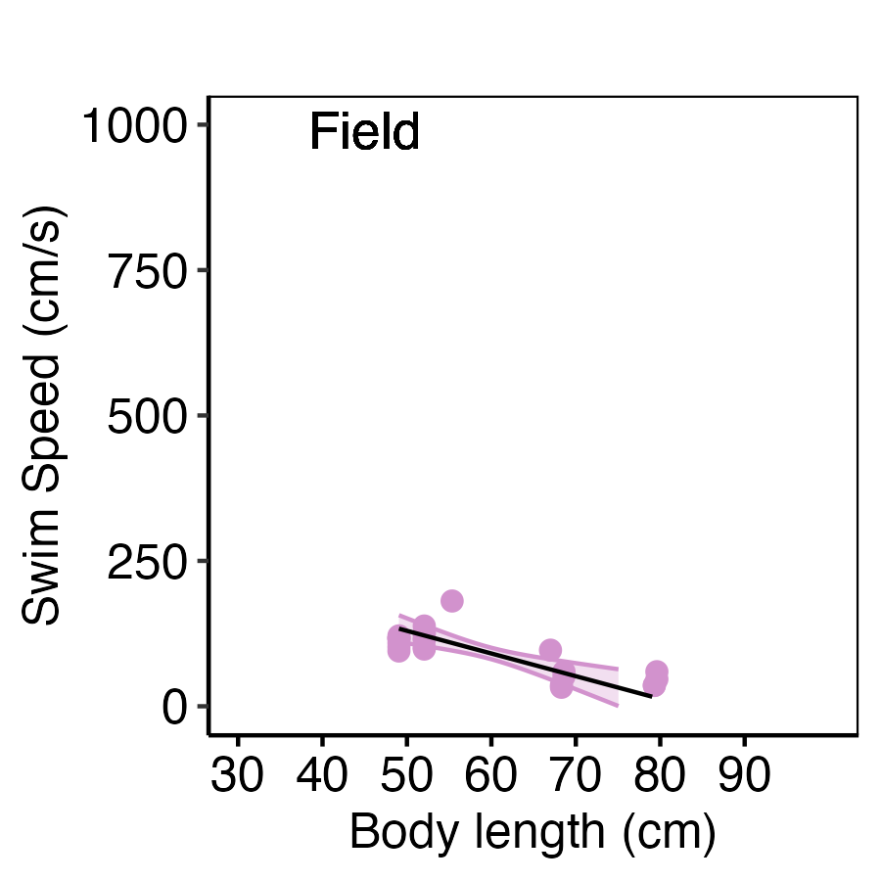
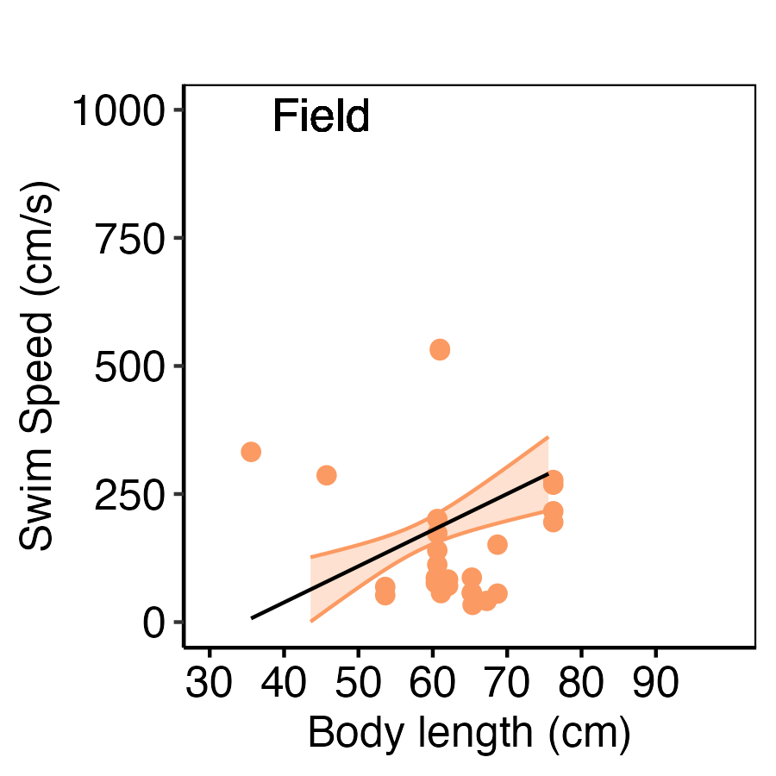
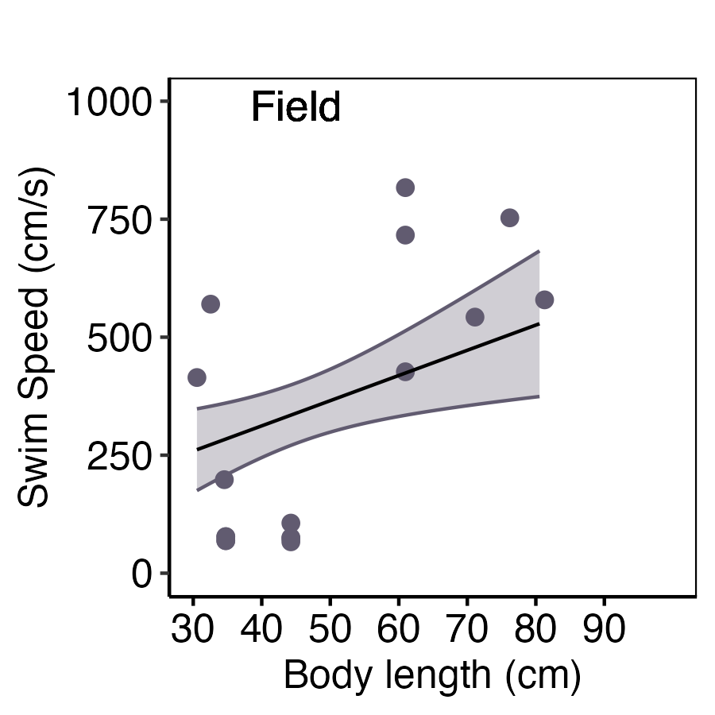
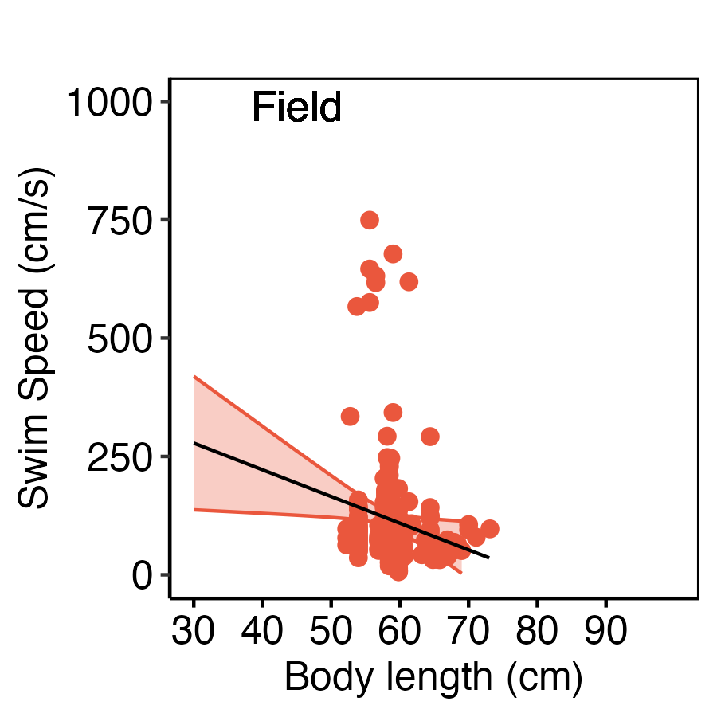
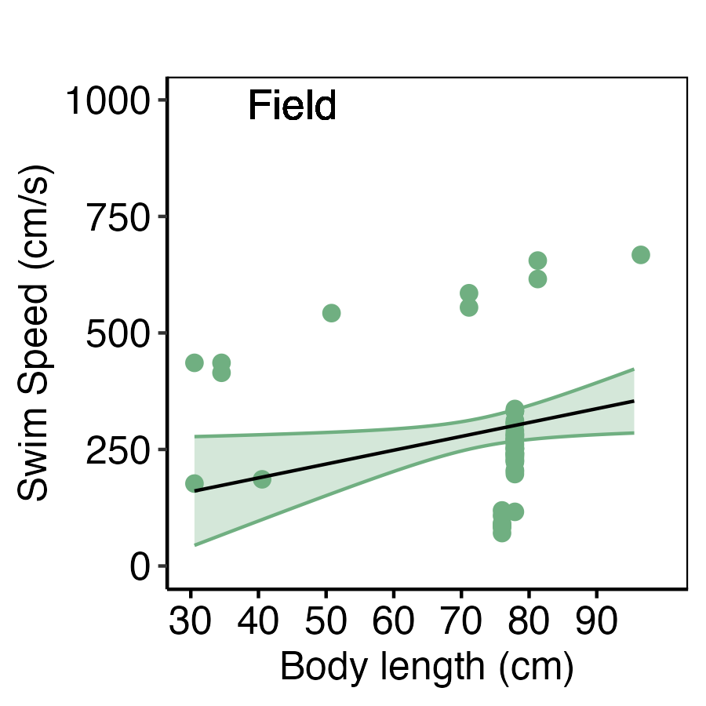
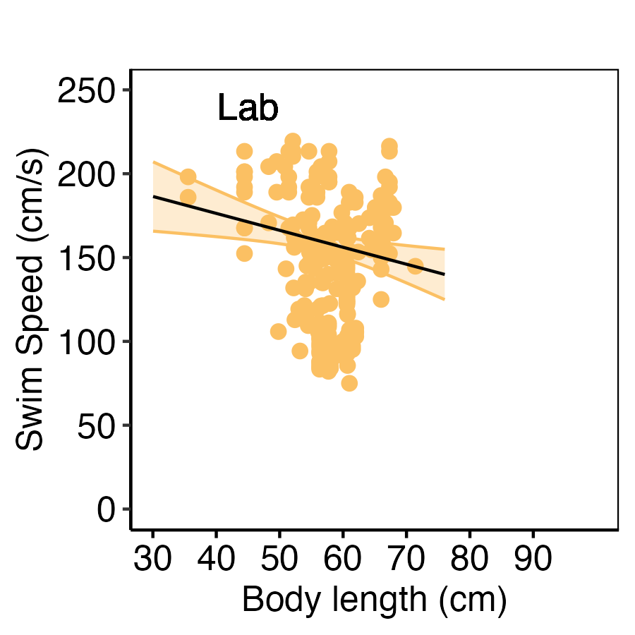
C

Slide 4
POST SWIM RECOVERY
(re-establish physiological baseline after aerobic and anaerobic swimming)
57 % (52/91) included studies addressed recovery
56 % (29/52)
discussed
PERFORMANCE EXAMINED:
Blood (18/23)
Heart (11/23)
Metabolism (18/23)
Somatic energy (6/23)
Repeat Swim (recovery ratio) (19/23)
46 % (23/52)
studied recovery
Notes:
How is body size shaping the optimal swimming – bursting performance and recovery performance? Are there any detectable trade-offs from the field study?

Slide 5
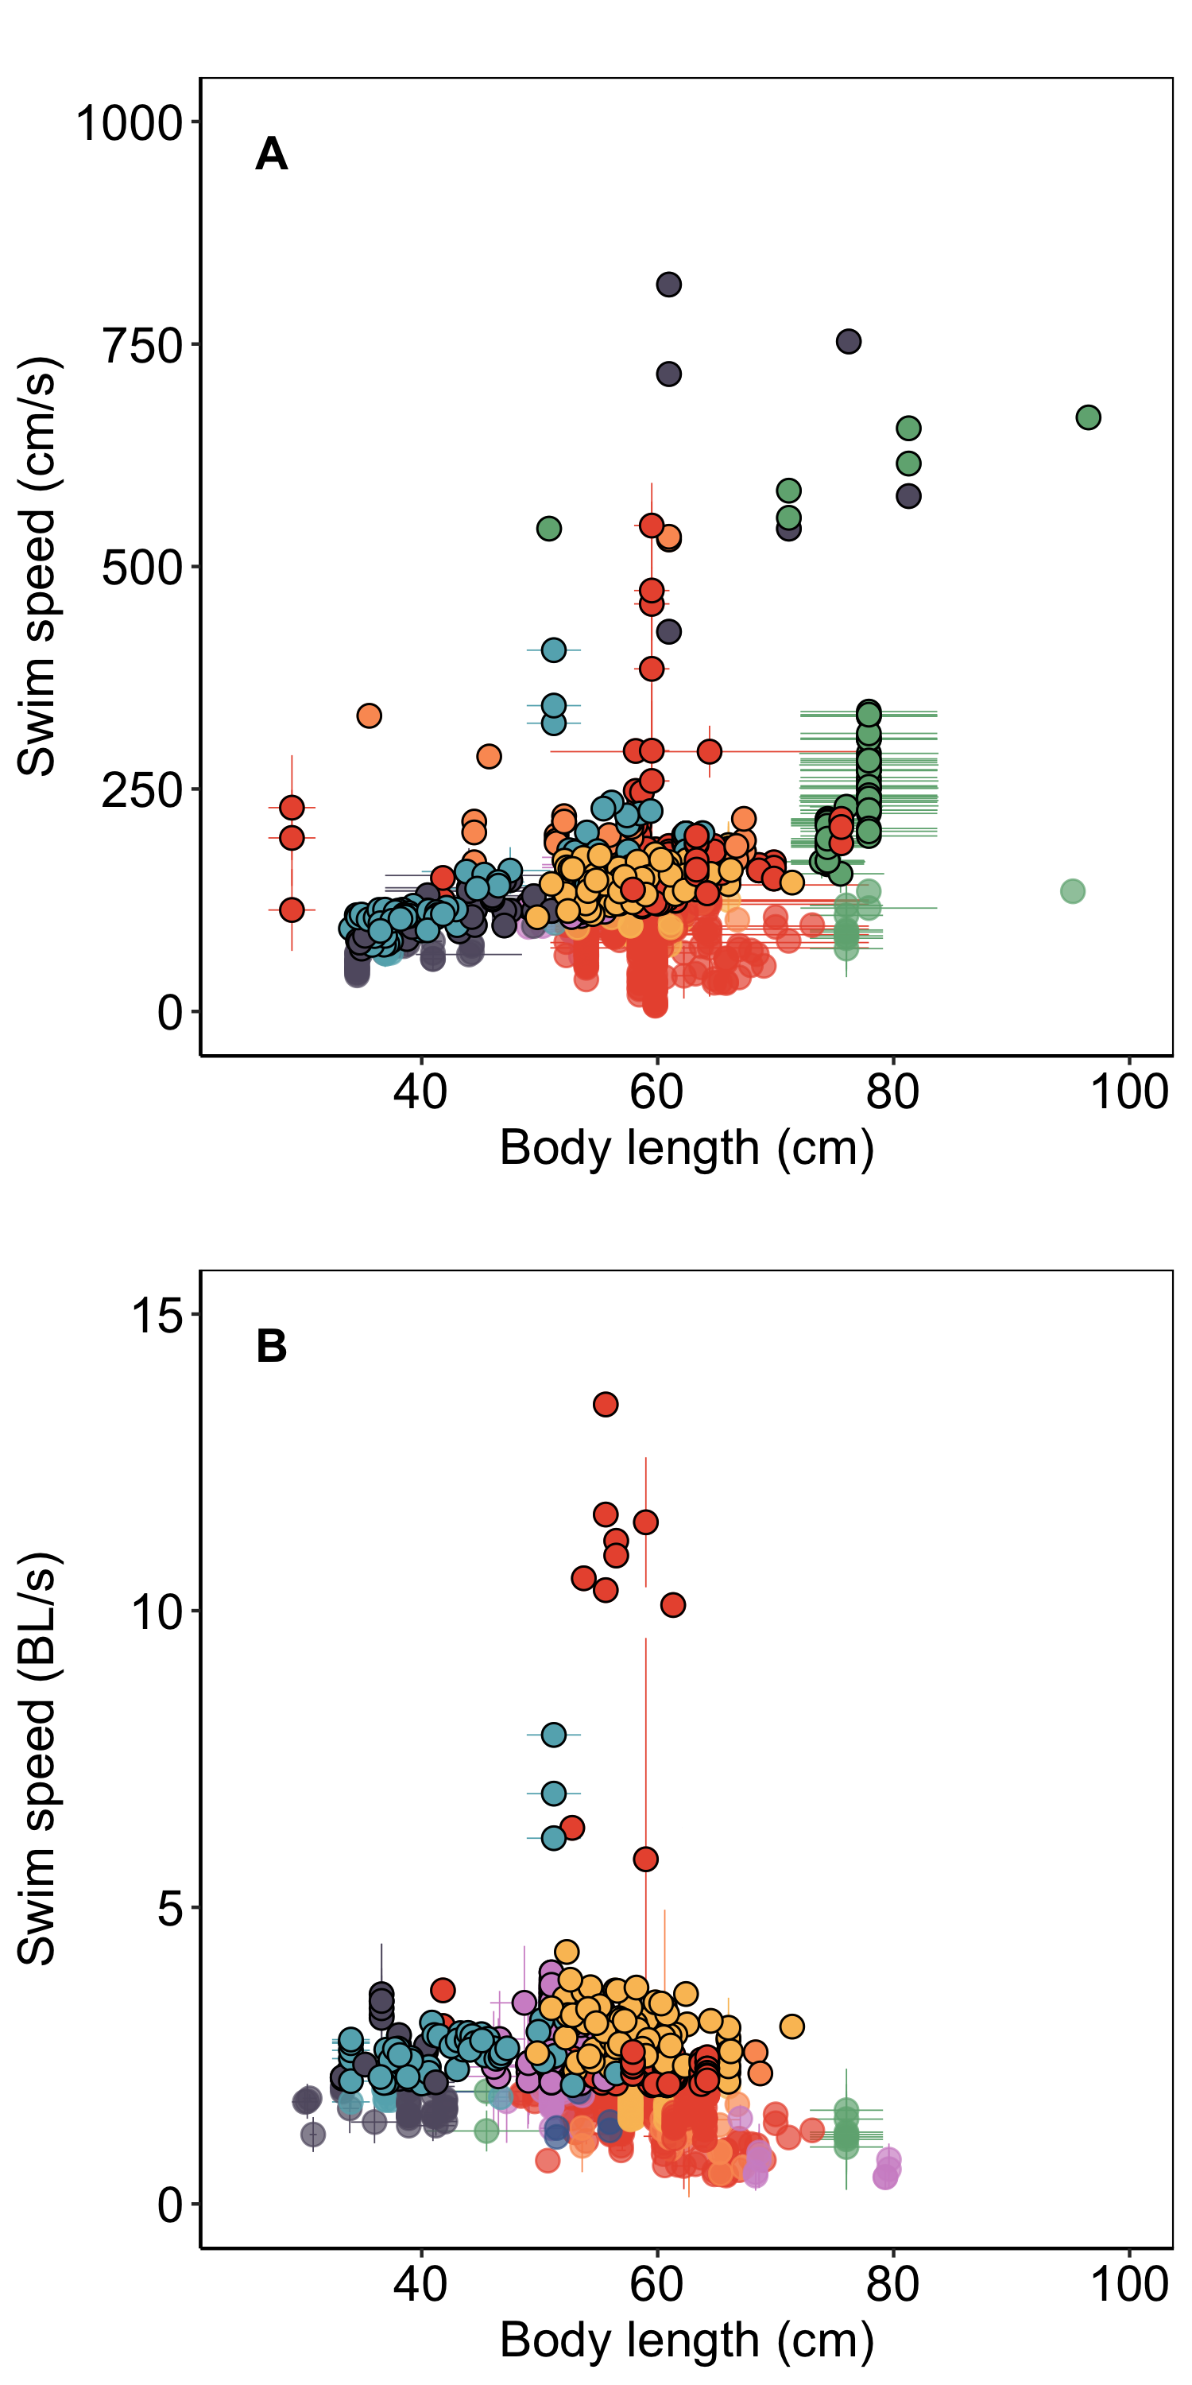
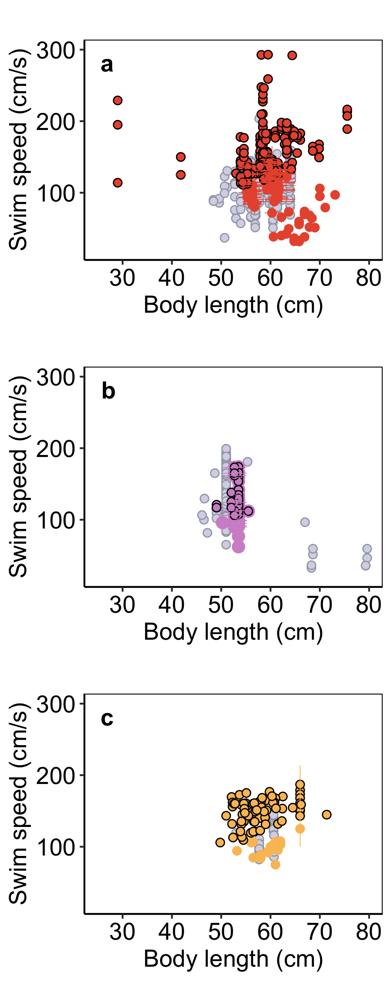
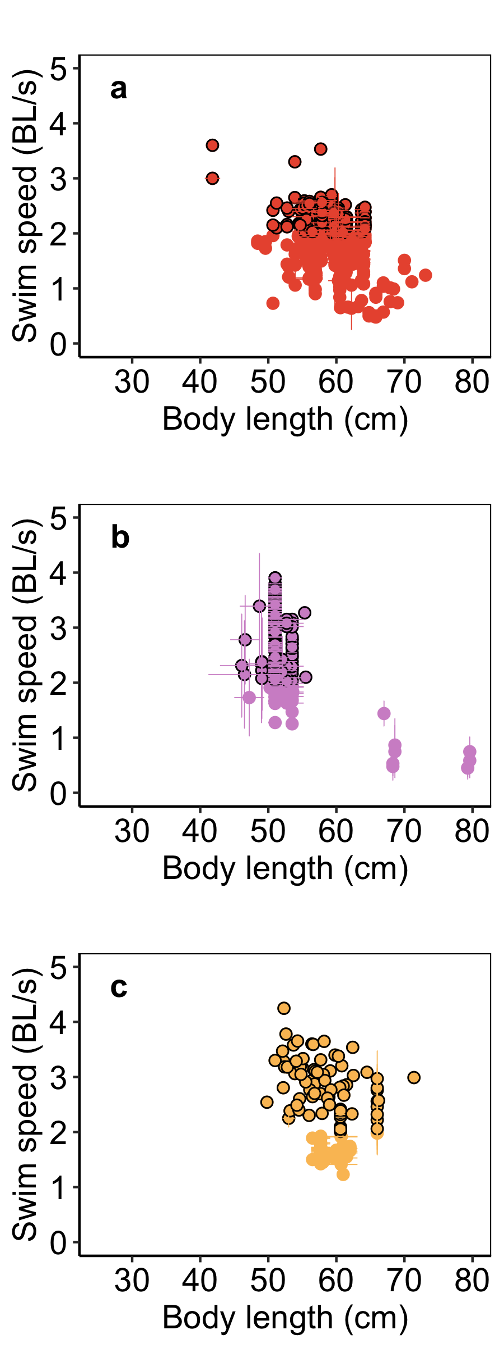
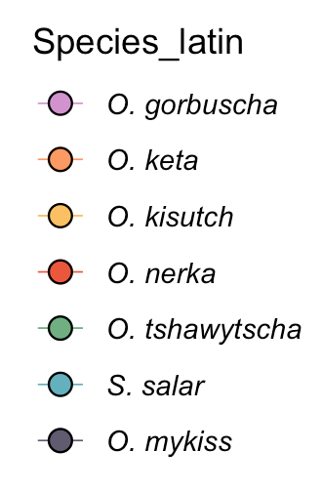
O. nerka
n =
O. gorbuscha
n =
O. kisutch
n =
BL/s > 5 (n=10)
O. nerka
n =
O. gorbuscha
n =
O. kisutch
n =

Slide 6
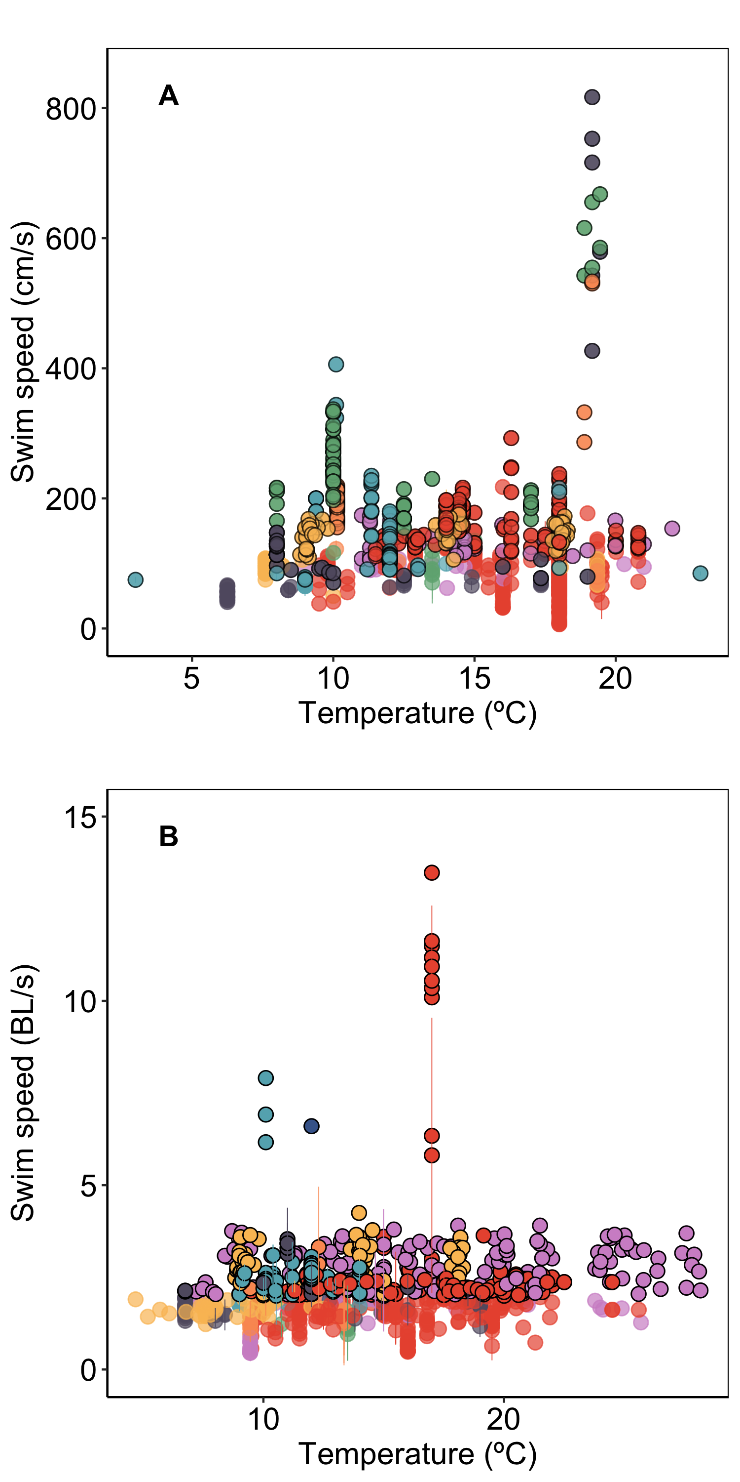
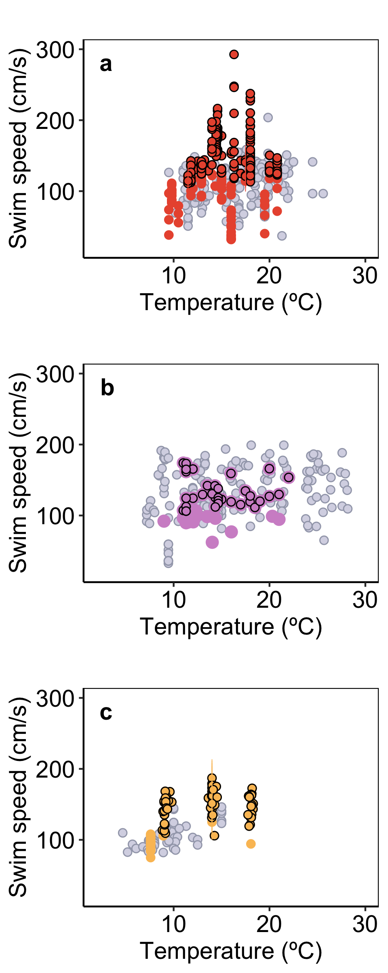
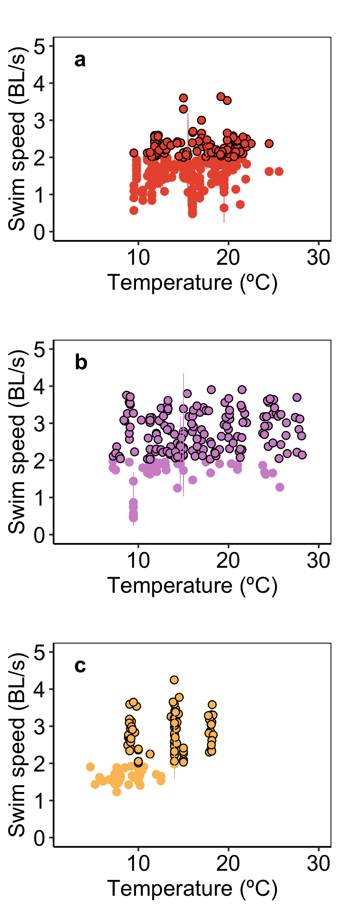
O. nerka
n =
O. gorbuscha
n =
O. kisutch
n =
BL/s > 5 (n=10)
O. nerka
n =
O. gorbuscha
n =
O. kisutch
n =

Slide 7
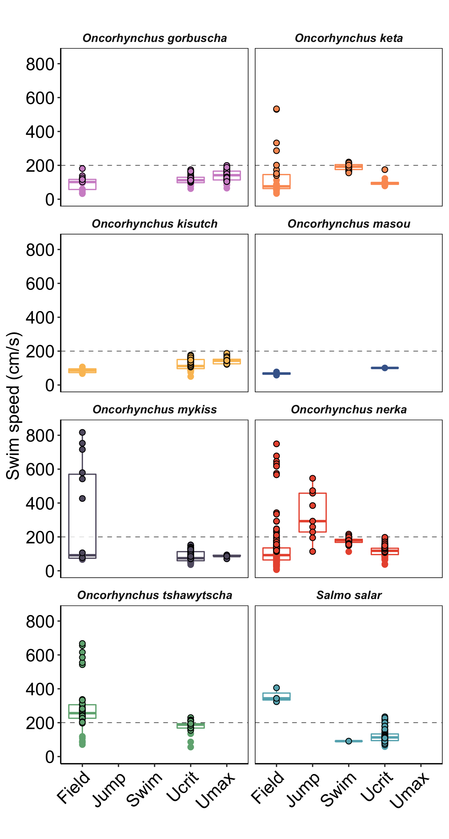
n =
n =
n =
n =
n =
n =
n =
n =
n =
n =
n =
n =
n =
n =
n =
n =
n =
n =
n =
n =
n =
n =
n =
n =
n =
n =
n =
n =
n =
n =
n =
n =
n =
n =
n =
n =
n =
n =
n =
n =
n =
n =
n =
n =
n =

Slide 8
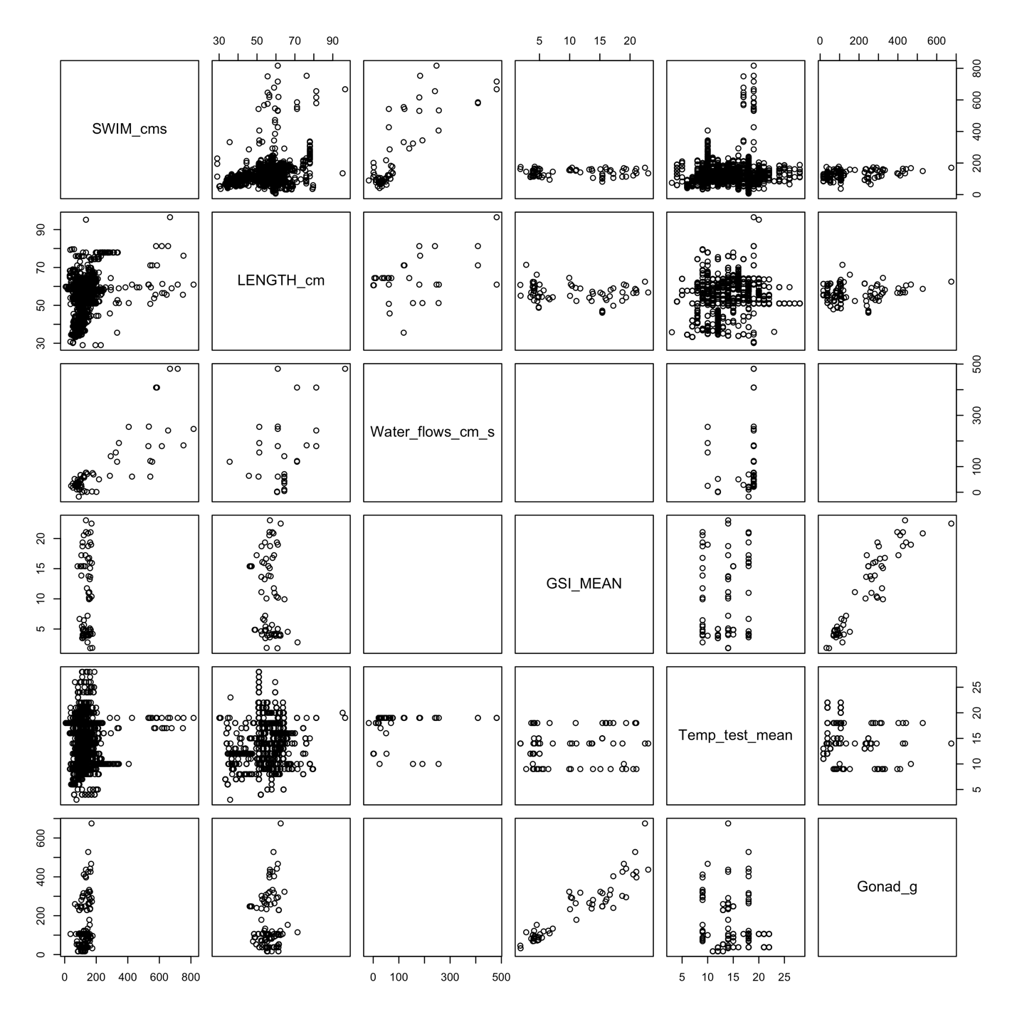
SWIM SPEED cm/s
FISH
LENGTH
cm
WATER FLOWS
cm/s
GONADO-SOMATIC INDEX
TEST TEMP. ºC
GONAD MASS
g

Slide 9
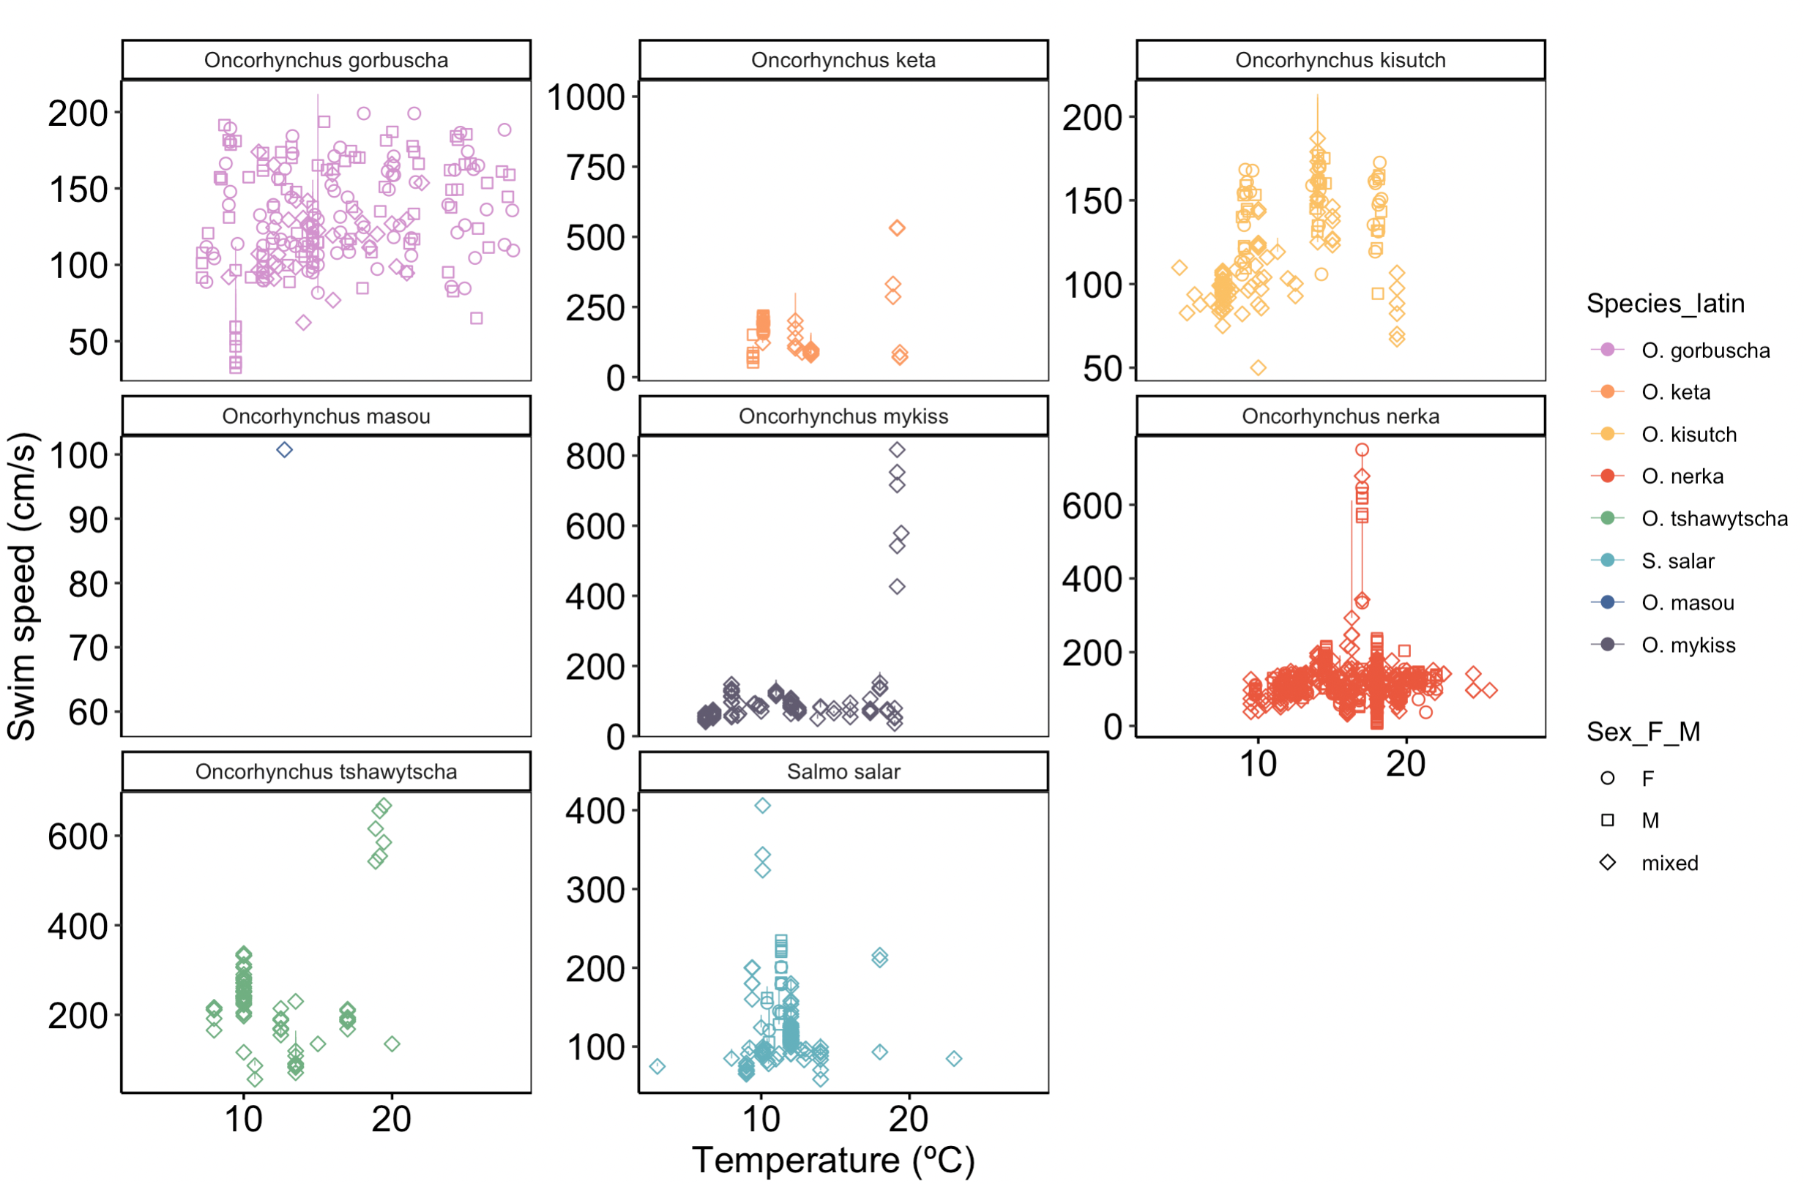
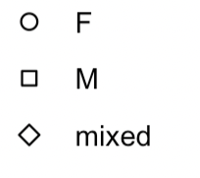
Sex

Slide 10
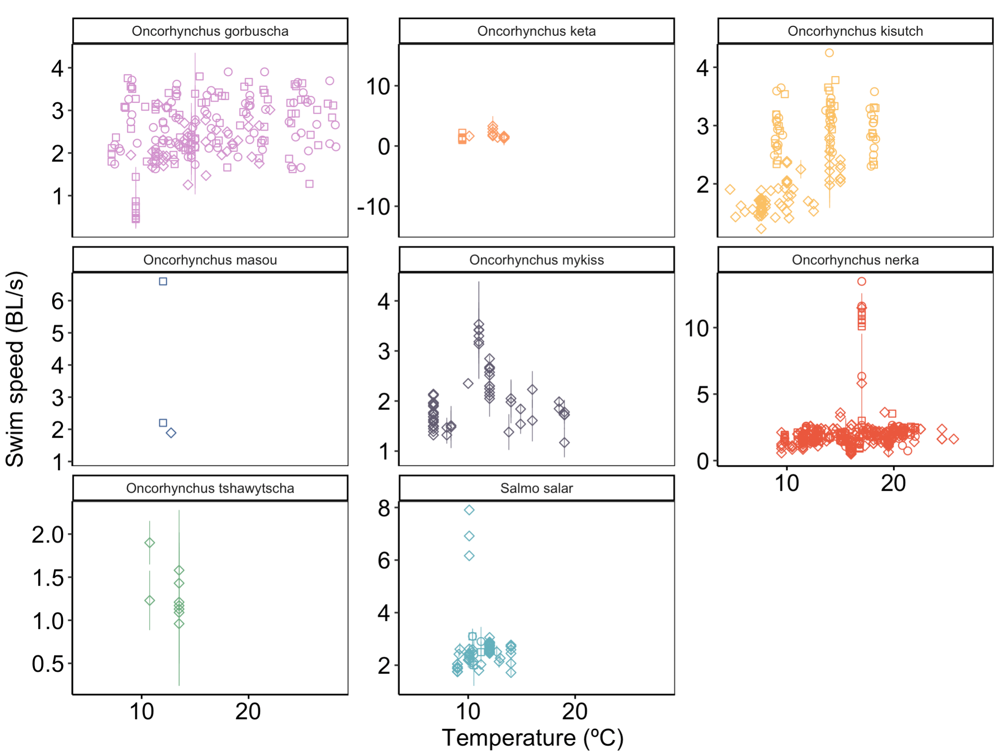
Sex

Slide 11
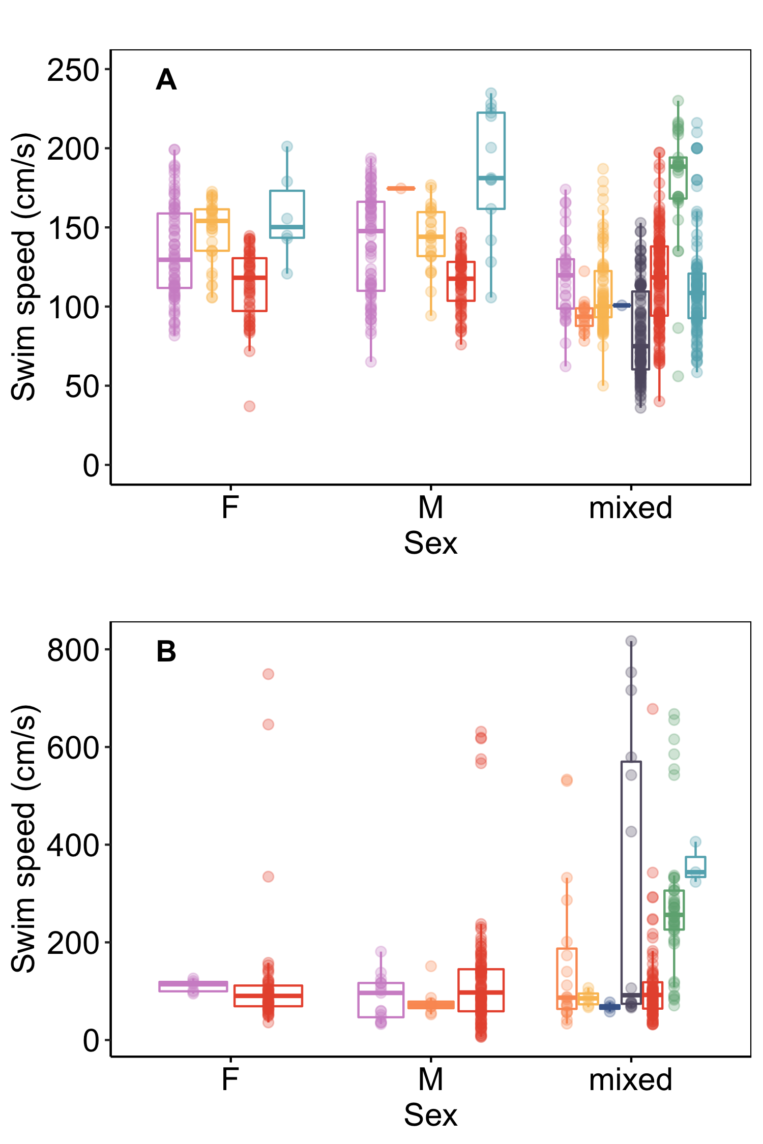

Slide 12
HOW WAS the DATA COLLATED (roadmap)
Option 1: plot only with Ucrit (mo2 ~ speed) trend, then I took the highest speed shown
Option 2: author reported calculated Ucrit speed (not just the highest speed, this follows the typical Ucrit calculation).

Slide 13



Learning from literature synthesis
Hinch and Bratty 2000
Fallback
Pass
burst
burst
Swim speed
Time
ANAEROBIC SWIMMING
(Fraser River Canyon, Hell’s Gate, Big Bar Rockslide)
RECOVERY
(re-establish physiological homeostasis after anaerobic swimming)
What is maximum reported swimming capacity in salmon?
57 % (50/87) of swim studies addressed recovery
87 Studies on Salmon swimming
52 Studies on Pacific Salmon
46 % (23/50)
Studied Recovery
54 % (27/50)
Discussed Only
Chinook salmon: 668 cm/s, 1.9 BL/s
Chum salmon: 533 cm/s, 3.32 BL/s
Pink salmon: 147 cm/s 3.90 BL/s
Sockeye salmon: 546 cm/s, 13.5 BL/s
Coho salmon: 187 cm/s, 4.25 BL/s
Blood Biochemistry
Metabolism
Cardiac physiology
Somatic Energy
Swim
Repeat Swim
(recovery
ratio)
Fatigue swim speeds
78 % (18/23)
87 %
(20/23)
43 %
(10/23)
26 %
(6/23)
How much is too much bursting (leads to fallback, or delayed mortality?)
83 %
(19/23)
30 %
(7/23)
Notes:
How is body size shaping the optimal swimming – bursting performance and recovery performance? Are there any detectable trade-offs from the field study?

Slide 14
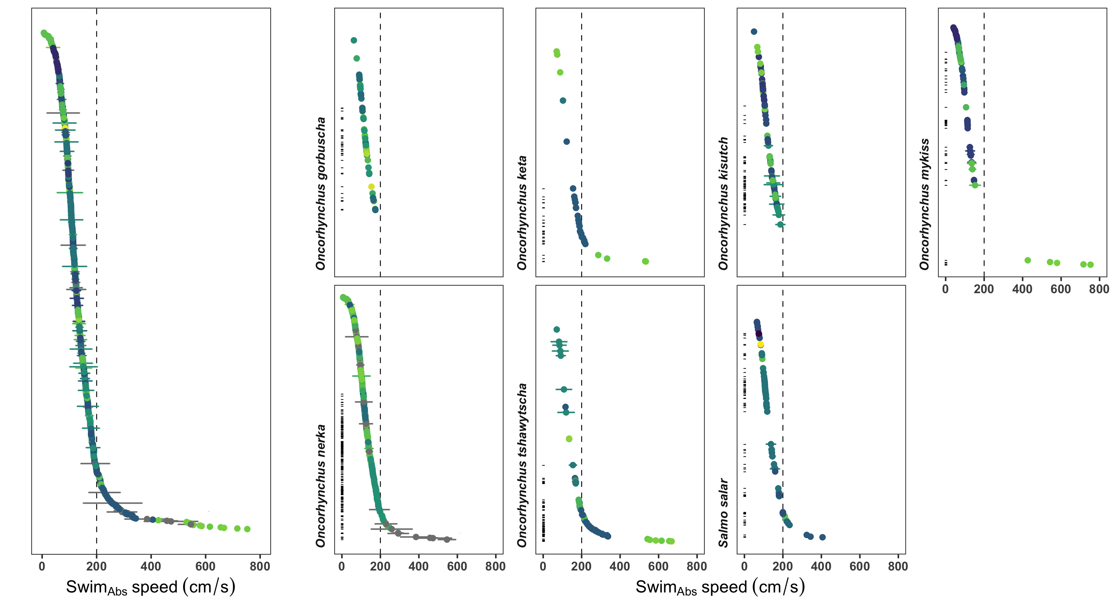


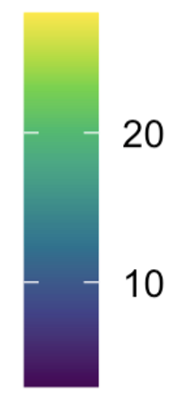
All data
combined
Max = 199 cm/s
Max = 533 cm/s
Max = 187 cm/s
Max = 817 cm/s
Max = 749 cm/s
Max = 668 cm/s
Max = 406 cm/s
Temperature
: marks estimated anaerobic (> 2 BL/s) swim speeds
Error is SD

Slide 15
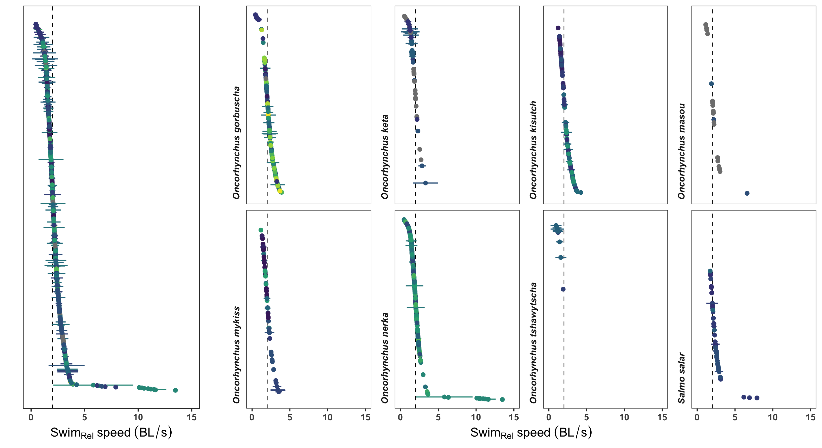
All data combined
Max = 3.90 BL/s
Max = 3.32 BL/s
Max = 4.25 BL/s
Max = 6.6 BL/s
Temperature
Max = 3.53 BL/s
Max = 13.5 BL/s
Max = 1.9 BL/s
Max = 7.91 BL/s

Slide 16
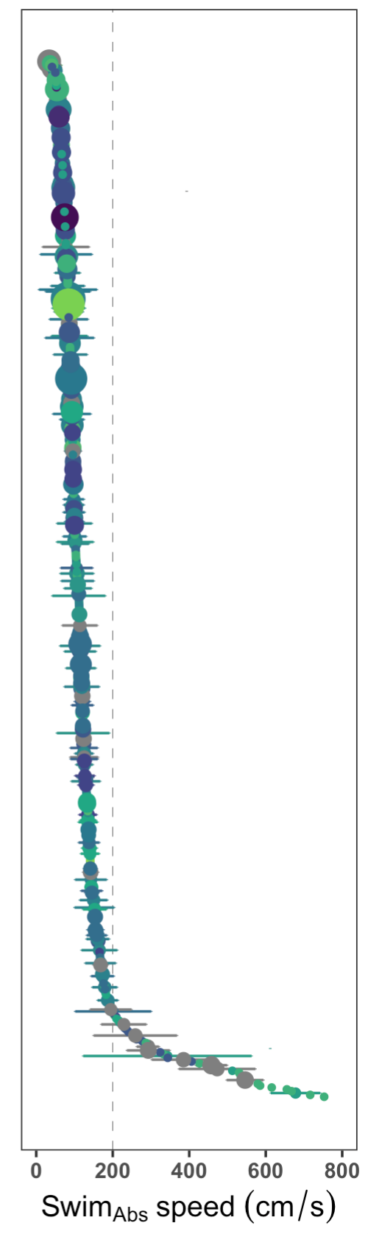
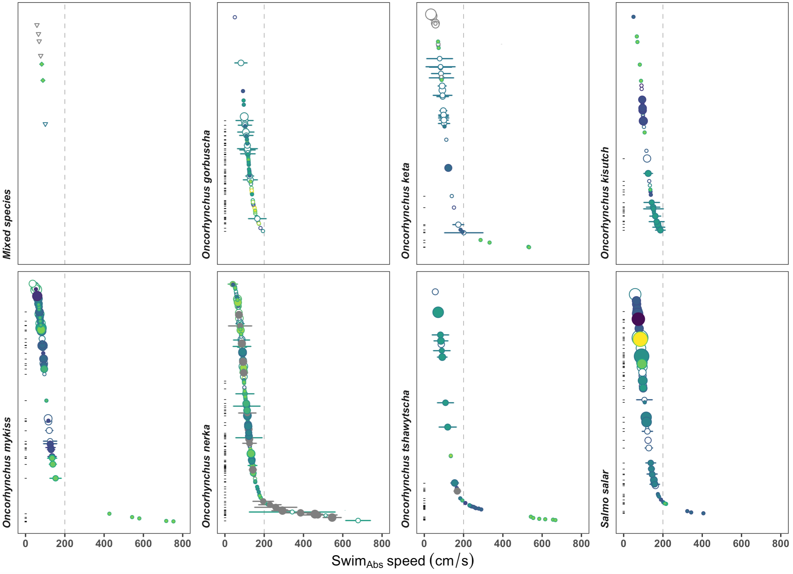
O. kisutch,
O. nerka combined
Max (reported) =
Max =
O. masou
estimated
reported
Max =
Max =
Max =
All species

Slide 17
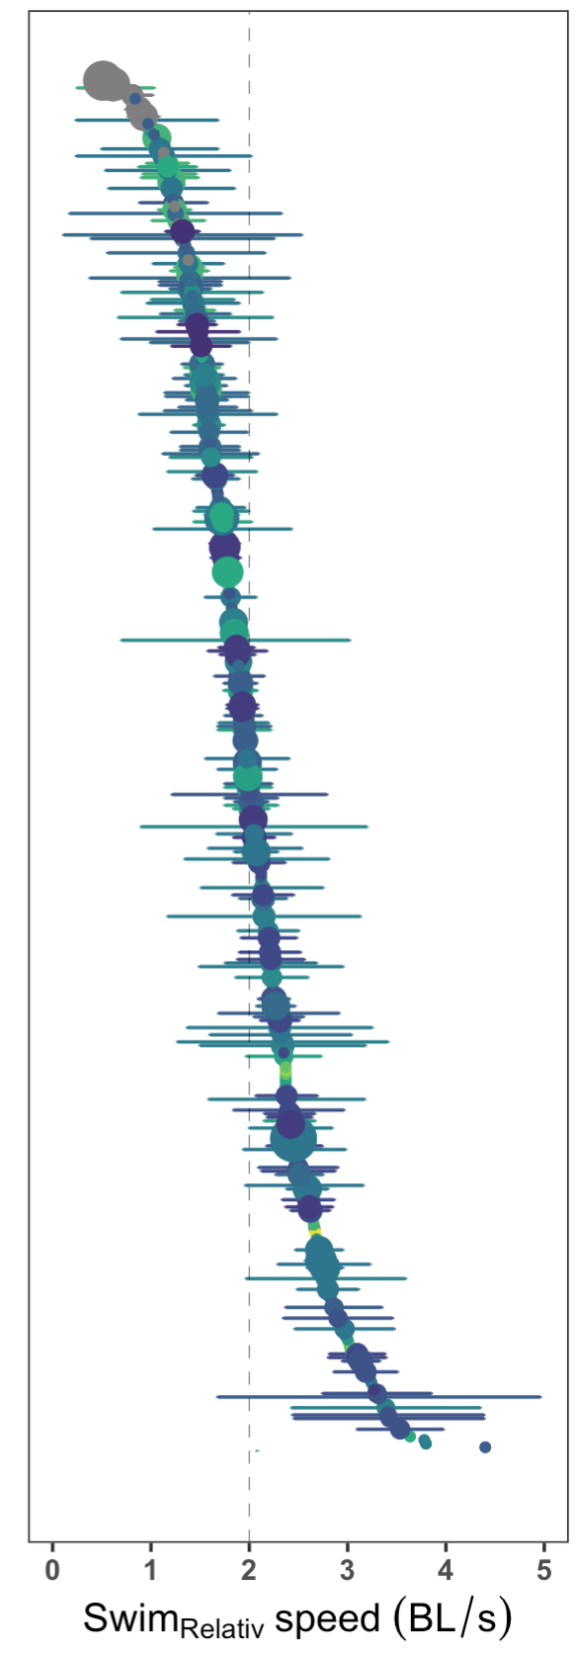
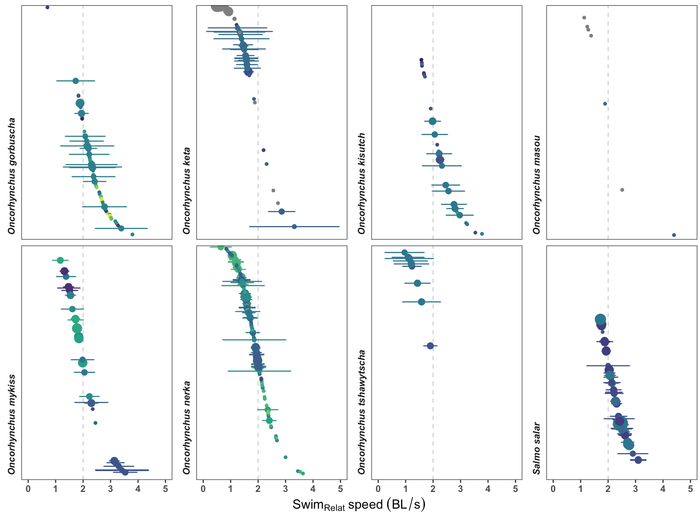
O. kisutch,
O. nerka combined
O. masou
reported
All species

Slide 18
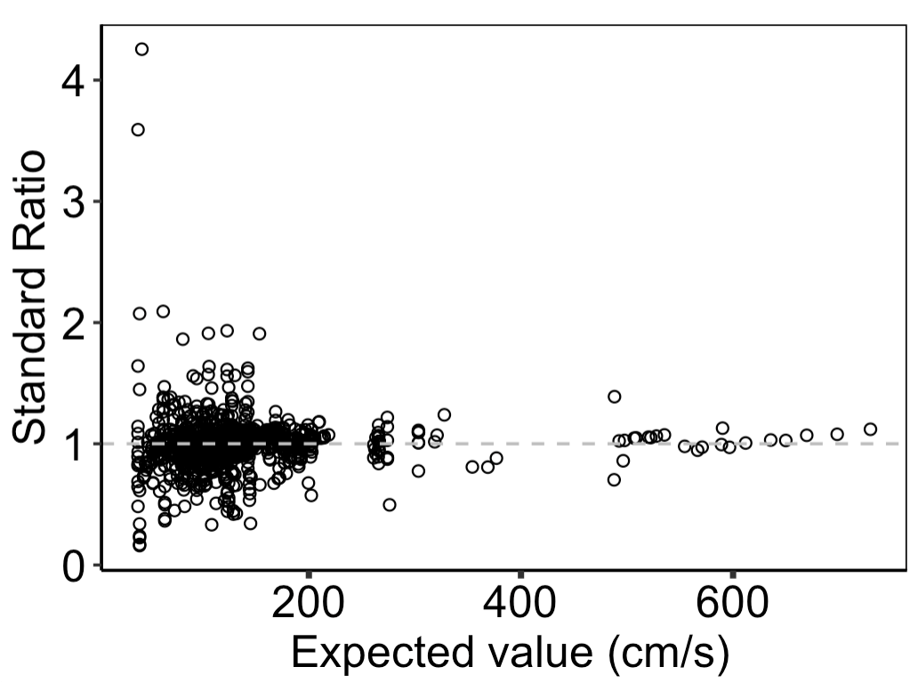
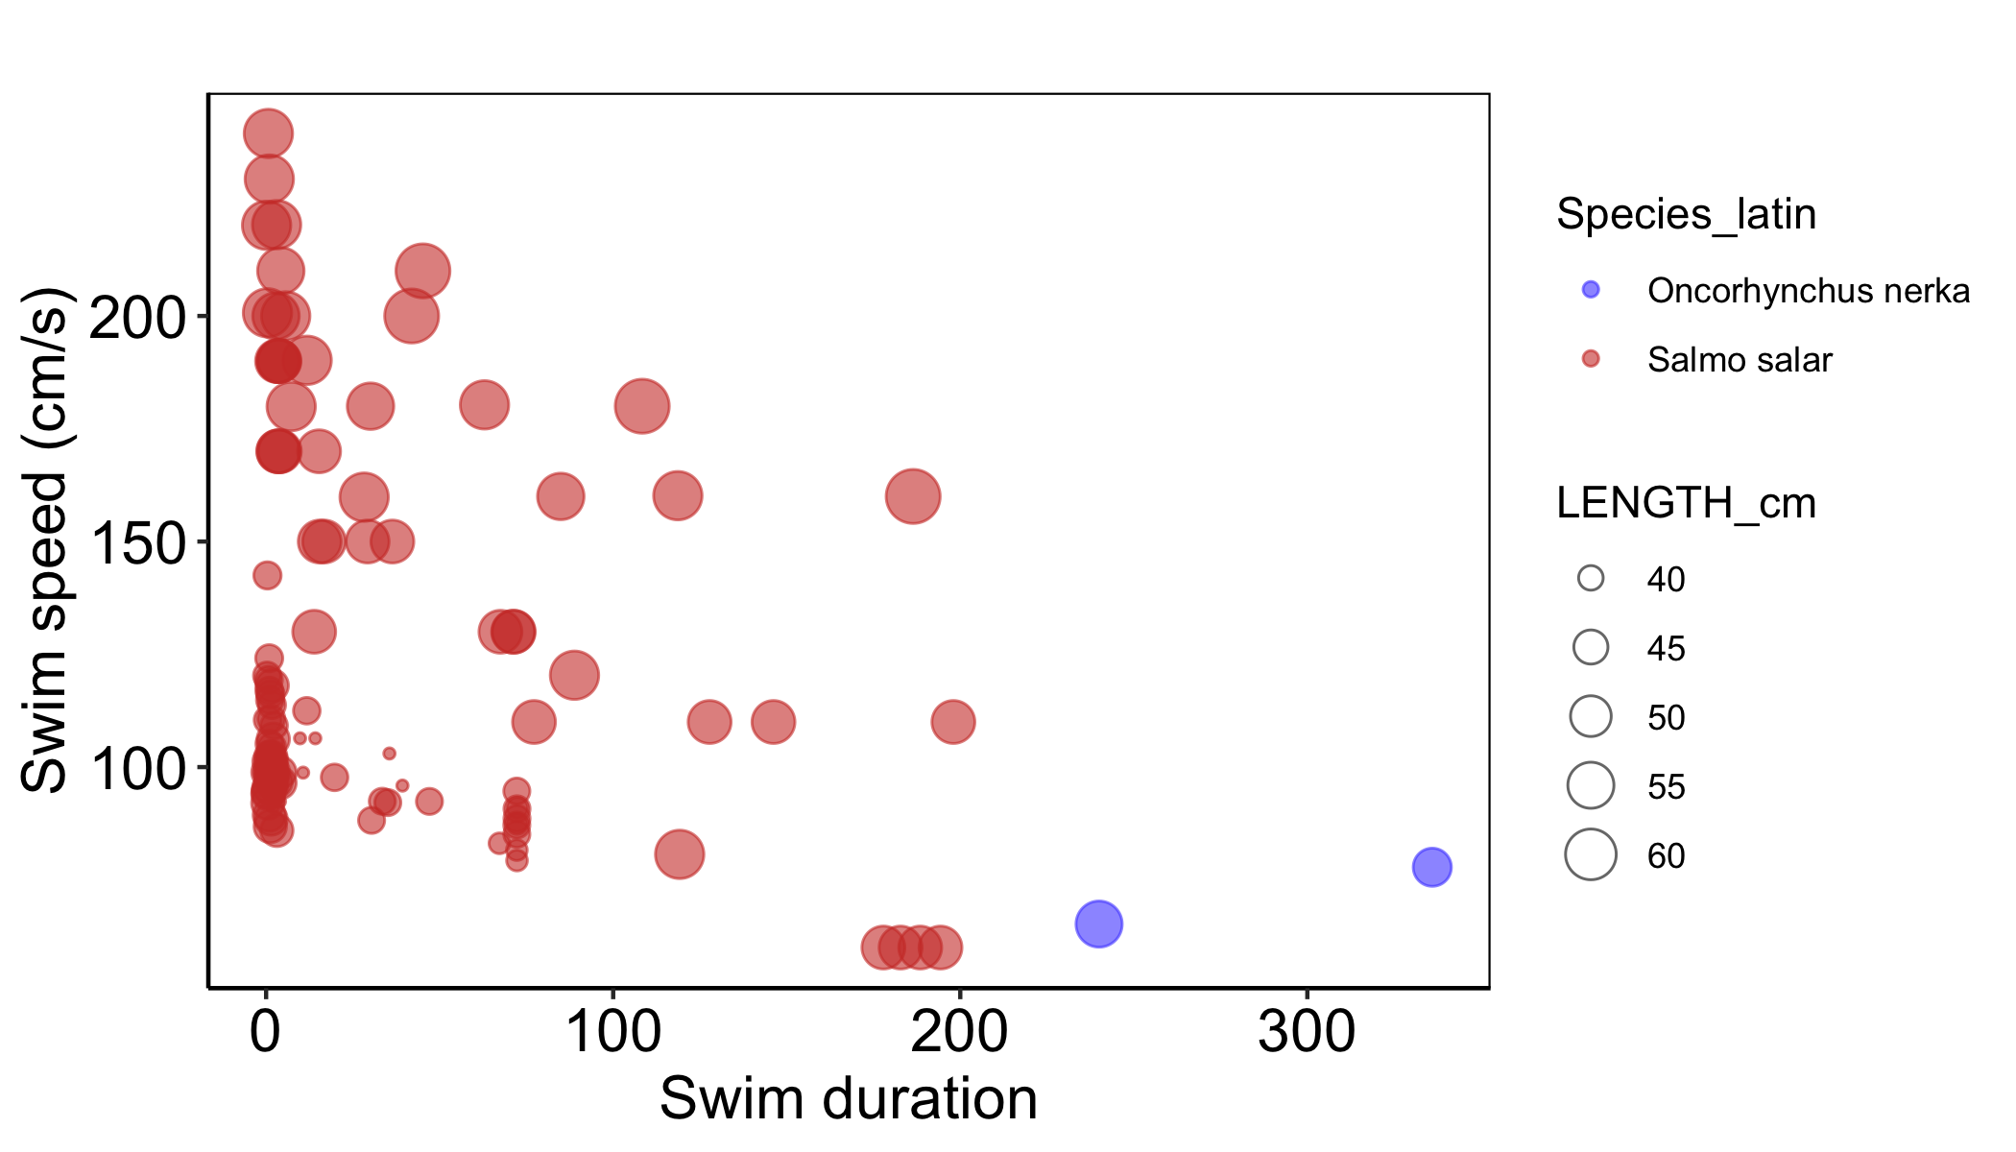

Slide 19
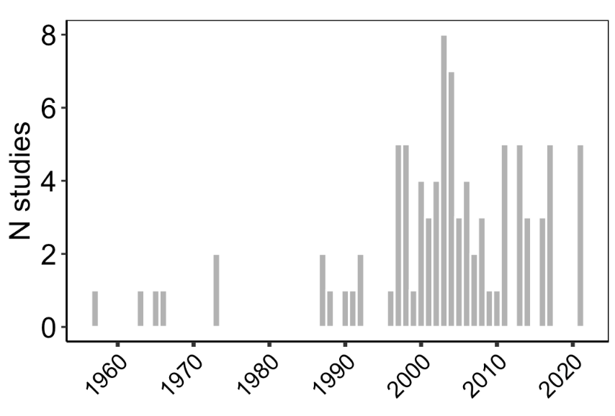

Slide 20
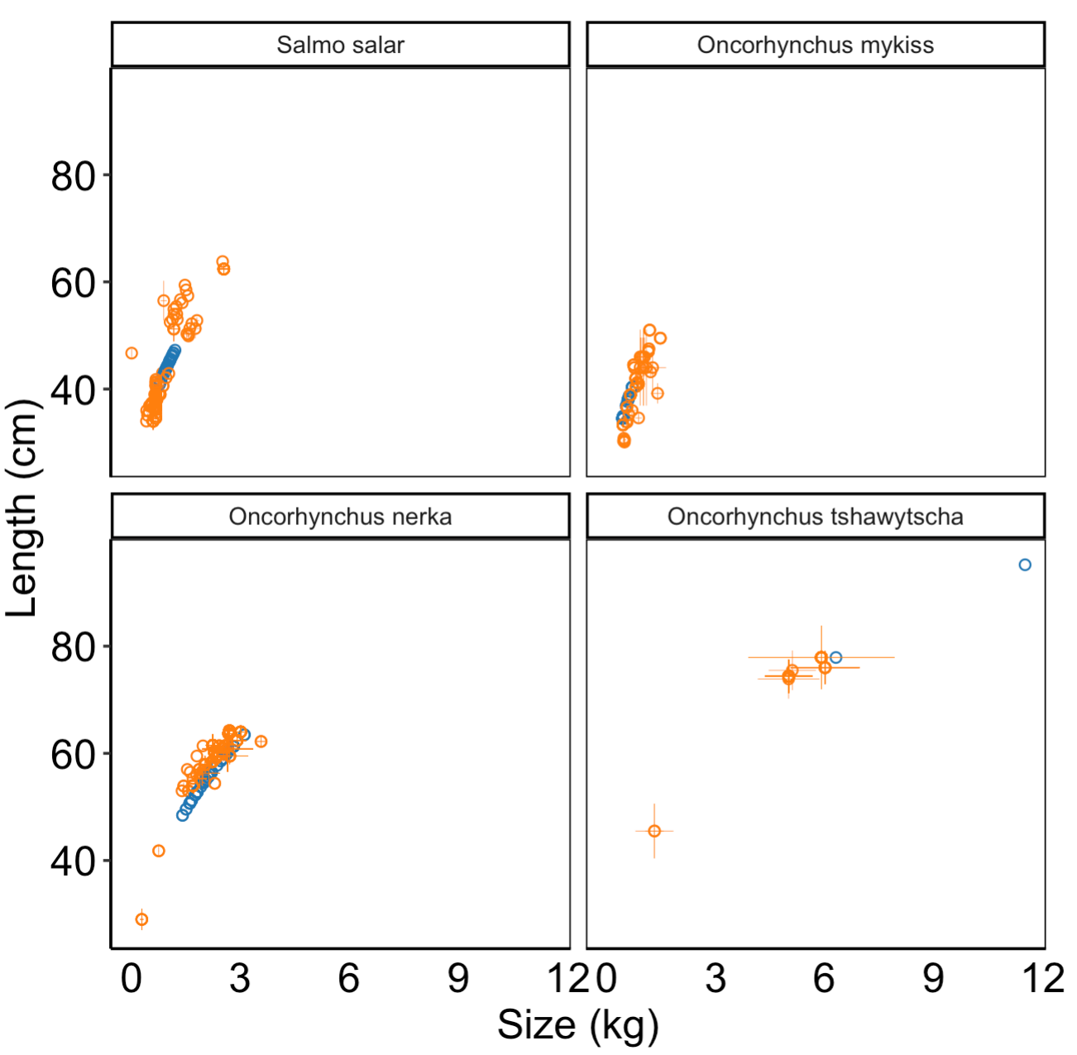
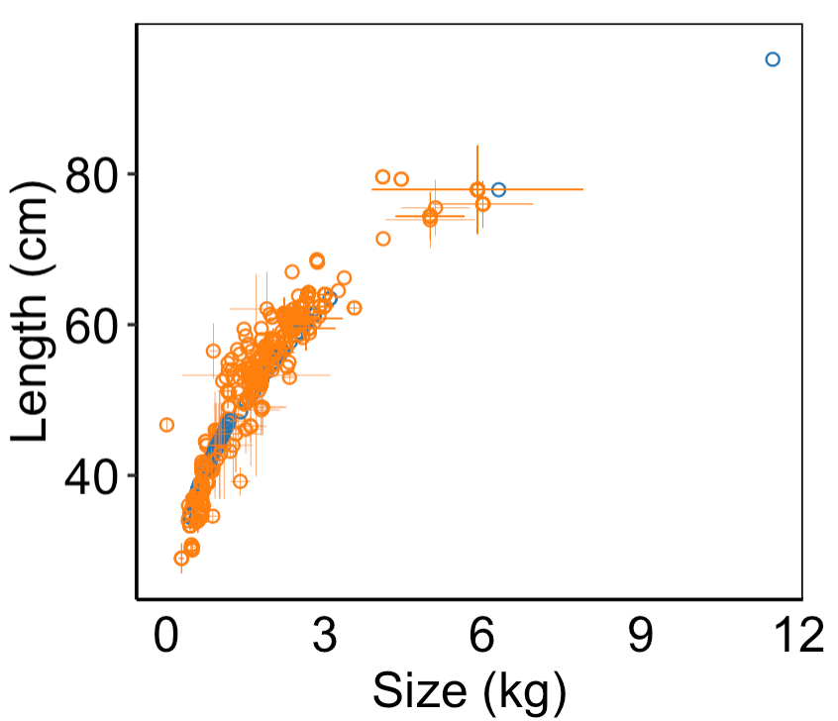
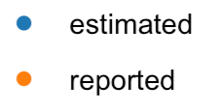
Weight = a * Length^{b}
Species | a | b
O. nerka | a = 0.01555 | b = 2.95
Salmo salar | a = 0.01047 | b = 3.02
O. tshawytscha | a = 0.01333 | b = 3.00
O. mykiss | a = 0.00955 | b = 3.03

Slide 21
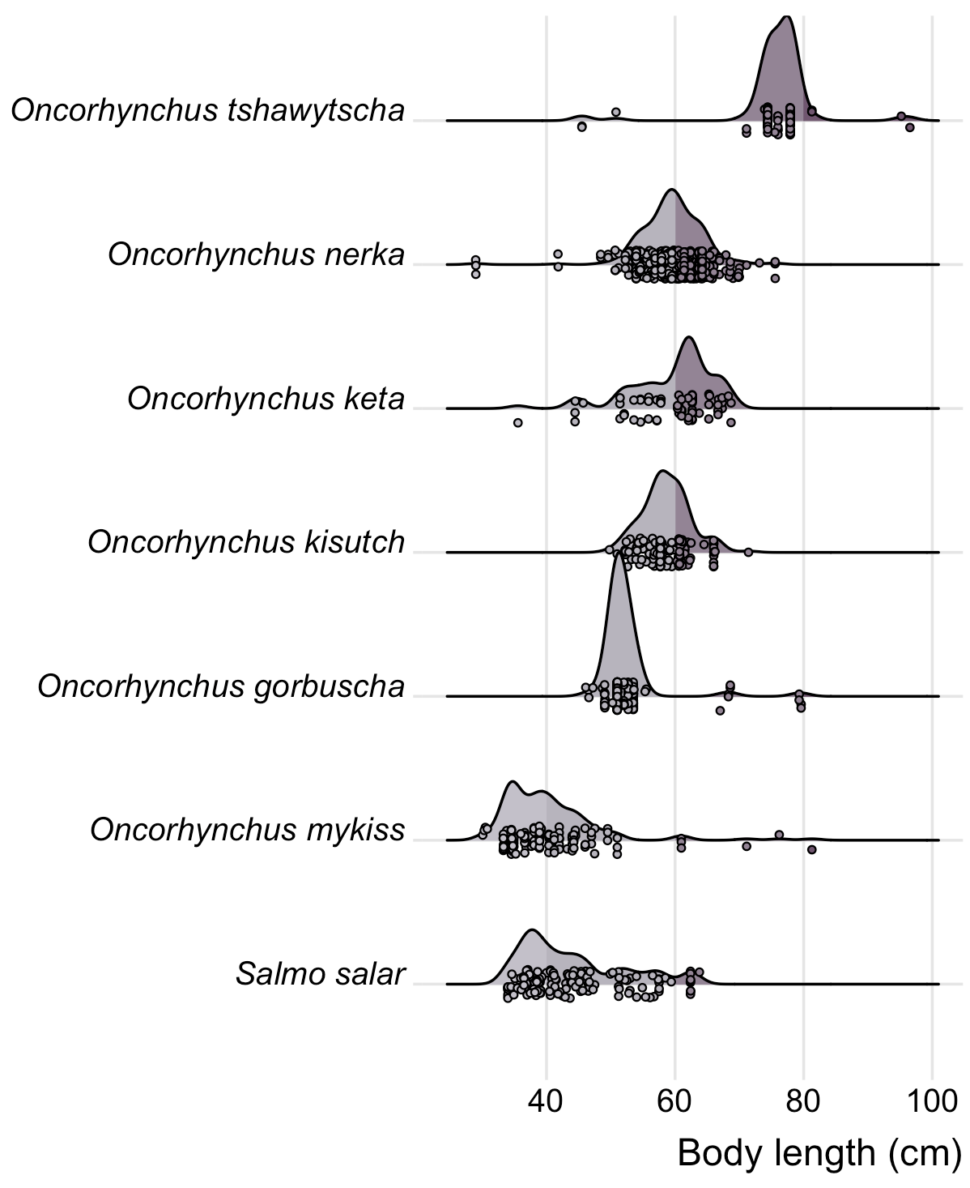
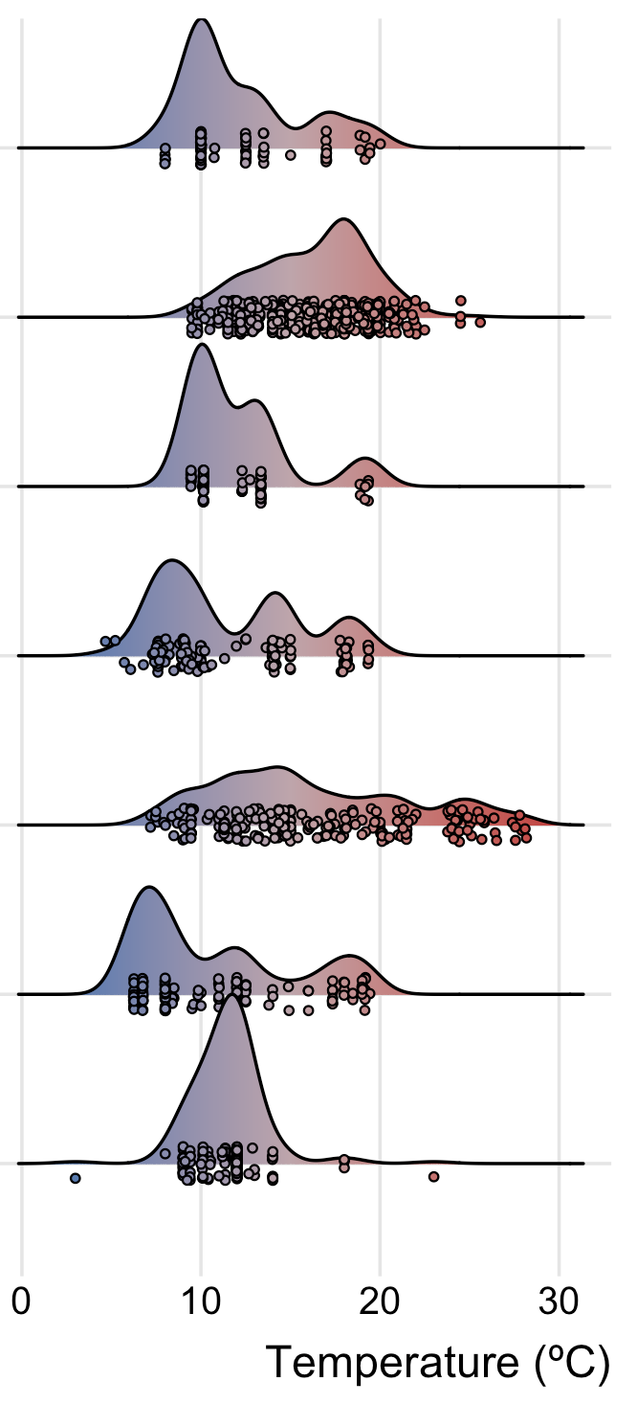
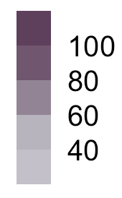
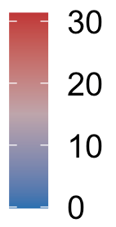
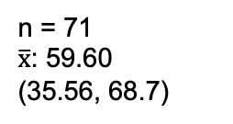
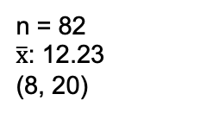
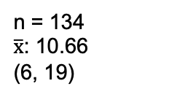
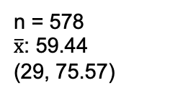










n = 83
$\overline{x}$ : 75.79
(45.5, 96.52)
n = 82
$\overline{x}$: 12.23
(8, 20)
n = 578
$\overline{x}$: 59.44
(29, 75.57)
n = 587
$\overline{x}$: 16.36
(10, 26)
n = 71
$\overline{x}$: 59.60
(35.56, 68.7)
n = 64
$\overline{x}$: 11.83
(9, 19)
n = 138
$\overline{x}$: 58.67
(49.8, 71.4)
n = 145
$\overline{x}$: 11.64
(5, 19)
n = 216
$\overline{x}$: 52.36
(46.1, 79.6)
n = 216
$\overline{x}$: 16.00
(7, 28)
n = 134
$\overline{x}$: 40.42
(30.1, 81.28)
n = 134
$\overline{x}$: 10.66
(6, 19)
n = 253
$\overline{x}$: 45.29
(34, 64)
n = 253
$\overline{x}$: 10.97
(3, 23)

Slide 22














Speed (all) = -37.18 + 2.86 * BL
Speed (< 250 cm/s) = 197.04 - 1.65* BL
Speed (> 250 cm/s) = 415.90 + 0.73* BL
Speed (all) = 78.75 + 1.91* BL
SPECIES- SPECIFIC RLEATIONSHIPS

Slide 23
















A
b
c
d
e
f
j

Slide 24




Slide 25



Slide 26



Speed = 78.746 + 1.914* BL
Speed = -32.699 + 7.311 * BL
Speed = -43.391 + 2.919 * BL

Slide 27
A
Estimated Swim_{Abs}
N = 624
(BL * Swim_{Relat})
Body Length (BL) Reported: N = 479
Swim_{Abs}
Swim
speeds
N = 1519
Directly reported Swim_{Abs} N = 895
Body Length Estimated:
N = 145
(Weight = a * Length^{b} )
a, b = Species specific coefficients
Swim_{Relat}
N = 986
B
XX Studies, n datapoints, other informative metrics? Just brainstorming
O. masou

